Slide 1


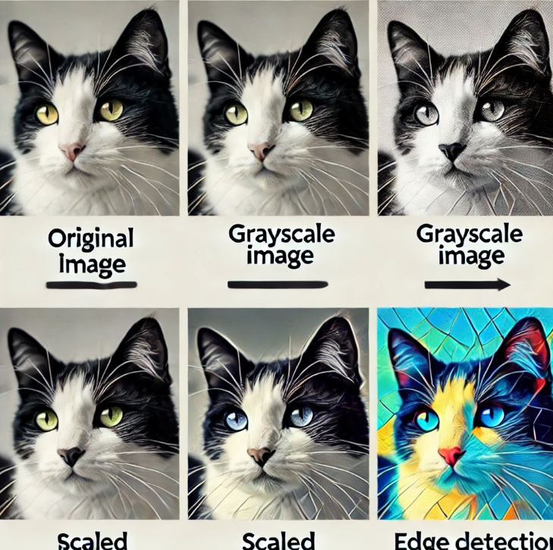
Session 10 :
Basic Image Transformations

Slide 2
Introduction
What is an Image?
An image is a picture we see on a computer, phone, or TV
What is an Image Transformation? Sometimes, we want to move, turn, or change a picture. This is called transformation!
Imagine playing with a puzzle—you can rotate a piece, flip it, or move it to fit in place!
Image transformations modify an image's appearance while preserving its essential structure. These transformations are widely used in image processing, computer vision, and AI applications.
Common transformations include:
Rotation (Turning an image by a certain degree)
Flipping (Mirroring an image along an axis)
Affine Transformations (Geometric modifications like scaling, translation, and shearing)
These transformations help in image alignment, data augmentation, feature extraction, and real-world applications such as medical imaging, computer vision, and augmented reality.

Slide 3
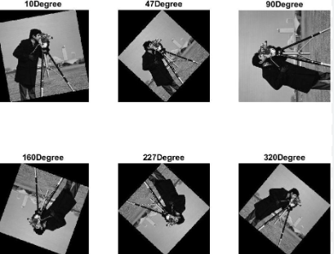
What is Rotation?
Rotation means turning a picture left or right, just like turning a steering wheel!
Rotation rotates an image around a fixed point (usually the center) by a specified angle.
Properties:
Maintains the image’s shape.
May introduce black padding around the edges.
Examples of Rotation:
Turning a clock’s hands
Spinning a fidget spinner
Rotating a paper while drawing
Aligning scanned documents.
Adjusting the orientation of images in computer vision tasks.
Fun Activity:
Try turning your book 45 degrees! That’s rotation!

Slide 4
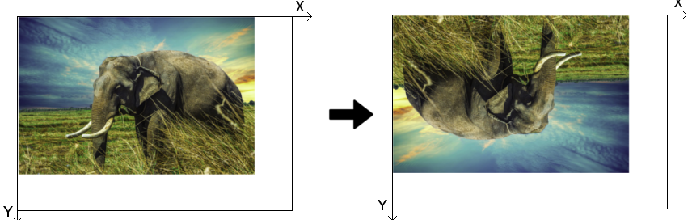
What is Flipping
Flipping means making a mirror image of a picture!
Flipping mirrors the image along a horizontal or vertical axis.
Types of Flipping:
Horizontal Flip: Left-right mirror effect. Like looking in a mirror! (Left becomes right)
Vertical Flip: Upside-down effect. Like a handstand! (Top becomes bottom)
Both Axes Flip: 180-degree flip.
Examples of Rotation:
Data augmentation in machine learning.
Correcting mirrored selfies.
Fun Activity:
Take a selfie and flip it using your phone!

Slide 5
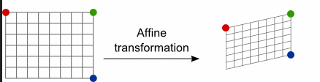
What is an Affine Transformation?
Affine transformation helps us move, stretch, or tilt pictures!
Affine transformations preserve collinearity and parallelism in an image while allowing translation, rotation, scaling, and shearing.
Common Affine Transformations:
Scaling: Enlarging or shrinking an image.
Translation: Moving an image to a different position.
Shearing: Slanting the image along an axis.
What Can We Do?
Move a picture from one place to another!
Stretch a picture to make it bigger or smaller!
Tilt a picture like leaning a chair!
Example Uses:
Geometric corrections in satellite imagery. Perspective adjustments in photography.
Fun Activity:
Stretch your hands wide like a big image, then small like a tiny one!

Slide 6
Write a script to rotate, flip, and apply transformations to an image.
import cv2
import numpy as np
from google.colab.patches import cv2_imshow # Import cv2_imshow for Colab
# Load the image
image = cv2.imread("/content/cat.png") # Change to your image file
# 1. Rotate 90 degrees
rotated = cv2.rotate(image, cv2.ROTATE_90_CLOCKWISE)
# 2. Flip the image
flipped_h = cv2.flip(image, 1) # Horizontal flip
flipped_v = cv2.flip(image, 0) # Vertical flip
# 3. Apply an affine transformation (shear)
rows, cols, _ = image.shape
pts1 = np.float32([[50, 50], [200, 50], [50, 200]])
pts2 = np.float32([[10, 100], [200, 50], [100, 250]])

Slide 7
Write a script to rotate, flip, and apply transformations to an image.
matrix = cv2.getAffineTransform(pts1, pts2)
transformed = cv2.warpAffine(image, matrix, (cols, rows))
# Display images using cv2_imshow
cv2_imshow(image)
cv2_imshow(rotated)
cv2_imshow(flipped_h)
cv2_imshow(flipped_v)
cv2_imshow(transformed)
cv2.waitKey(0)
cv2.destroyAllWindows()

Slide 8



Output

Slide 9
Exercise
1. What is the purpose of an image transformation? A) To convert an image to a video B) To change an image’s colors only C) To move, turn, or change the structure of an image D) To compress the image
Answer: C) To move, turn, or change the structure of an image
2. What is rotation in image processing? A) Moving an image to a different folder B) Turning an image left or right around a fixed point C) Zooming into an image D) Blurring the edges of an image
Answer: B) Turning an image left or right around a fixed point

Slide 10
Exercise
3. Which of the following describes a vertical flip? A) The left becomes the right B) The top becomes the bottom C) The image rotates 180 degrees D) The image gets stretched horizontally
Answer: B) The top becomes the bottom
4. What does an affine transformation allow you to do? A) Change the color scale of an image B) Add filters to an image C) Move, scale, rotate, or shear the image while preserving structure D) Convert image to grayscale
Answer: C) Move, scale, rotate, or shear the image while preserving structure

Slide 11
Exercise
5. Which Python function is used to perform an affine transformation in OpenCV? A) cv2.flip() B) cv2.rotate() C) cv2.getAffineMatrix() D) cv2.warpAffine()
Answer: D) cv2.warpAffine()

